Slide 1
COMP 2230
Week 12 - Wednesday

Slide 2
Last time
Exam 3
Before that:
  Review
Before that:
  Analysis of algorithms
  Exponential and logarithmic functions

Slide 3
Questions?

Slide 4
Assignment 6

Slide 5
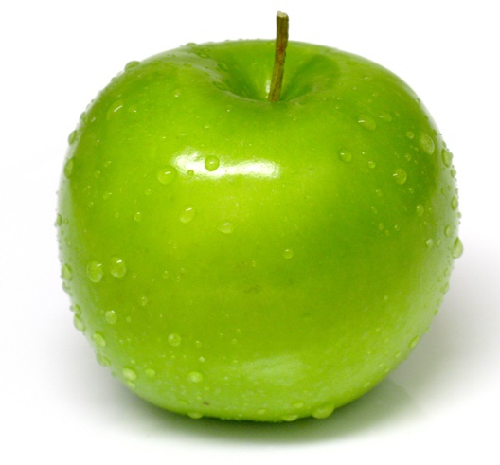
Logical warmup
There are ten baskets of apples
The number of apples in each basket ranges from 10 to 20
Nine of the baskets contain apples weighing 4 ounces each
One basket has apples weighing 5 ounces each
Unfortunately, we've lost track of the basket of heavy apples, which your boss wants
All the apples look the same
You have a weighing scale measuring in ounces, and an empty basket
But we're just about to ship these apples out!
You only have time to make one measurement with your scales
How do you find the heavy basket?
This Photo by Unknown Author is licensed under CC BY-SA

Slide 6
Exam 3 Post Mortem

Slide 7
Formal Languages and Regular Expressions
Three-Sentence Summary

Slide 8
Formal Languages

Slide 9
Formal languages
Computer science grew out a lot of different pieces
  Mathematics
  Engineering
  Linguistics
Describing an algorithm precisely requires that it be framed in terms of some formal language with exact rules

Slide 10

Rules
We say that a language is a set of strings
A string is an ordered $n$-tuple of elements of an alphabet $Σ$ or the empty string $ε$ (which has no characters)
An alphabet $Σ$ is a finite set of characters

Slide 11
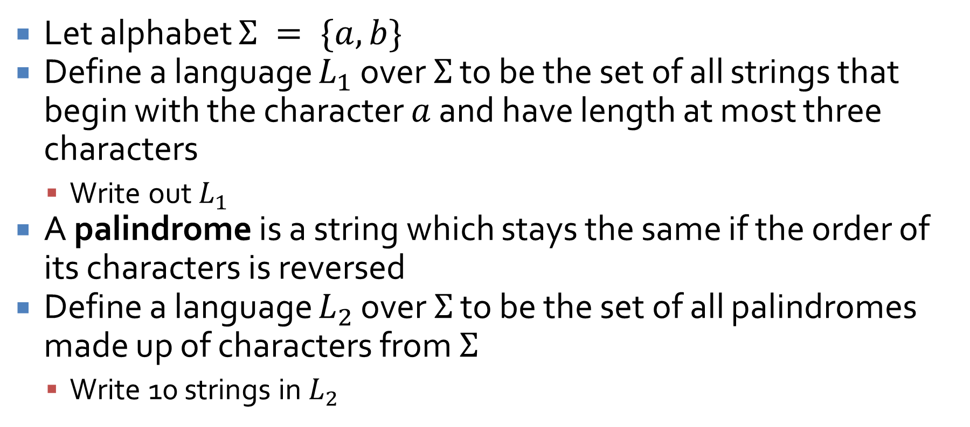
Examples
Let alphabet $Σ = \{a, b\}$
Define a language $L_{1}$ over $Σ$ to be the set of all strings that begin with the character $a$ and have length at most three characters
  Write out $L_{1}$
A palindrome is a string which stays the same if the order of its characters is reversed
Define a language $L_{2}$ over $Σ$ to be the set of all palindromes made up of characters from $Σ$
  Write 10 strings in $L_{2}$

Slide 12
Ticket Out the Door

Slide 13
Upcoming

Slide 14
Next time…
No class Friday!
Finish introduction to formal languages
Finite state automata

Slide 15
Reminders
Start Assignment 6
Read 12.2 for Monday
  Prepare a three-sentence summary
  Extra credit if you get called on

